Slide 1

ROAD SIGN CLASSIFICATION
string_the_boys
GROUP DETAILS:
Manan Vadaliya (AU2040264)
Harshrajsinh Vaghrola (AU2040195)
Pruthviraj Dodiya (AU2040175)
Mohsinali Vijapura (AU204080)

Slide 2
PROBLEM STATEMENT
The goal is to create a reliable system that can be used to enhance road safety by alerting drivers of any road signs they might have missed or misunderstood.
Train and classify traffic signs using convolutional neural networks (CNNs) in real-time with the help of OpenCV and a simple webcam.
To develop efficient model using TensorFlow and Keras that can identify 43 different classes of traffic signs.
The dataset used consists of over 35,000 images of traffic signs to train the model.

Slide 3
INTRODUCTION
In this project, we will leverage the power of deep learning and computer vision techniques to develop an image classification system.
CNNs is used in the field of recognition due to it's ability to generalize and classify data with high accuracy.
The model can be utilised to improve the safety of autonomous vehicles and driver support systems.
We aim to have a robust and accurate traffic sign recognition system that can be used to enhance road safety.

Slide 4
THE EXISTING BODY OF WORK
ROAD SIGNAL RECOGNITION CAN BE PERFORMED USING VARIOUS ALGORITHMS CONVOLUTIONAL NEURAL NETWORKS (CNN), SUPPORT VECTOR MACHINES (SVM), DECISION TREES, RANDOM FOREST, HOUGH TRANSFORM AND ETC.
ACCURACY OF 98.58% WHEN THE NETWORK IS TRAINED USING THE TENSORFLOW AND KERAS LIBRARIES.

Slide 5
OUR APPROACH
Dataset Preparation: We used dataset containing the information from 43 different classifications of traffic signs. This dataset is then split into training, validation, and testing sets. The dataset was imbalanced so we balanced using data augmentation method.
Preprocessing: To prepare the dataset for training, we had applied several preprocessing steps, normalization of images, grey scale conversion of images and equalization of images . This helps to reduce overfitting and improve the generalization of the model.

Slide 6
OUR APPROACH
CNN Model Architecture: We implement a CNN model using TensorFlow Keras, consisting of multiple convolutional and pooling layers, followed by fully connected layers. We use a softmax activation function in the output layer to predict the class probabilities of the input image.
Model Training: The CNN model is trained using the training dataset and optimized using the validation dataset. We use categorical cross-entropy as the loss function and the Adam optimizer to minimize the loss.

Slide 7
OUR APPROACH
Model Evaluation: The trained model is evaluated on the testing dataset to measure its accuracy and performance. We will also perform a confusion matrix analysis to visualize the performance of the model across different classes.
Deployment: Finally, the trained model can be deployed to recognize traffic signs in real-time using a camera feed or static images. This can be done using various techniques, such as image segmentation and object detection, to locate and recognize the traffic signs in the input images.

Slide 8
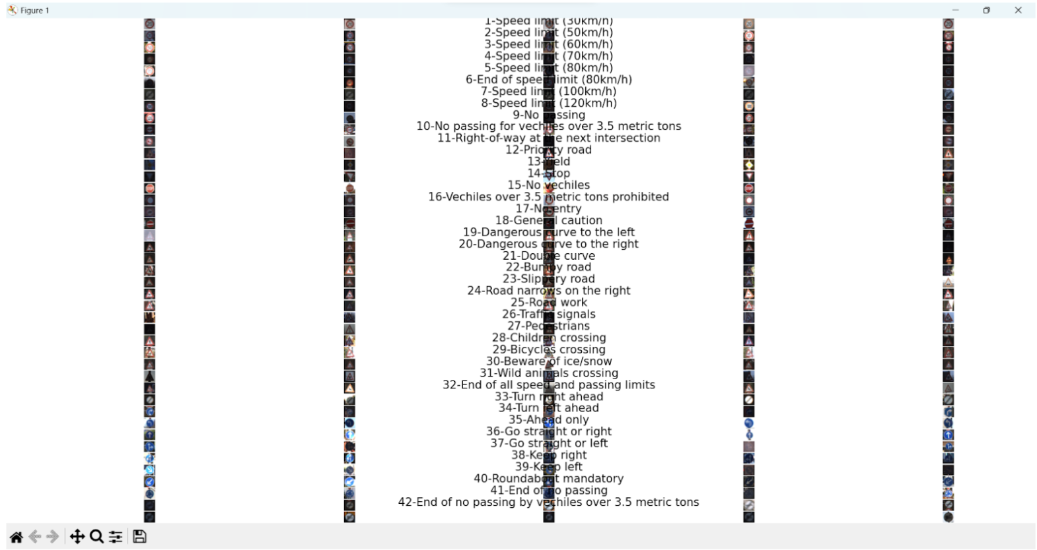
FINAL RESULTS
The above picture describes all the 43 classes that are classified by training of our model for the given in the dataset.

Slide 9
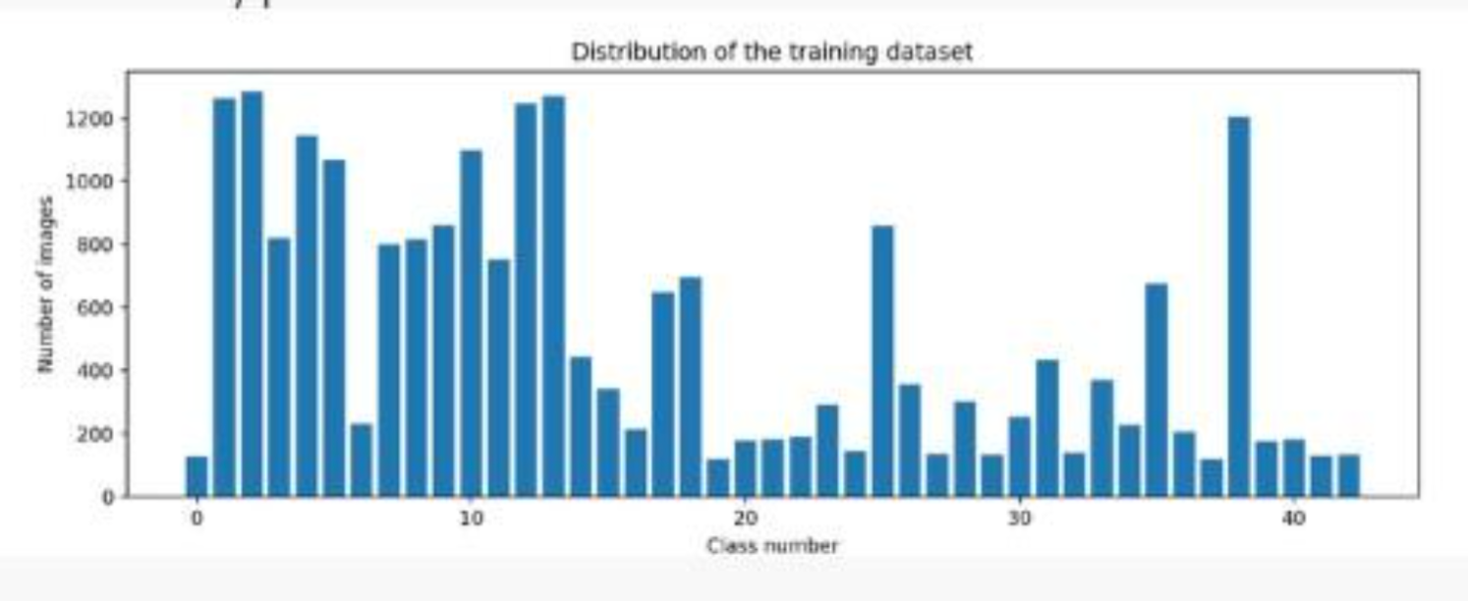
FINAL RESULTS
The above picture describes the frequency distribution of each class(i.e type of road sign) from the dataset.

Slide 10
FINAL RESULTS
The above image denotes the pre-processing of the dataset images by converting them to :
Grayscale
Standardizing the lighting in image
Normalizing the image from 0 to 1 instead of 0 to 255

Slide 11
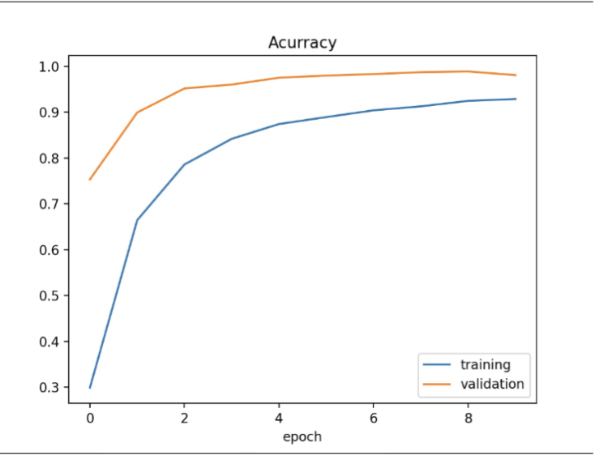
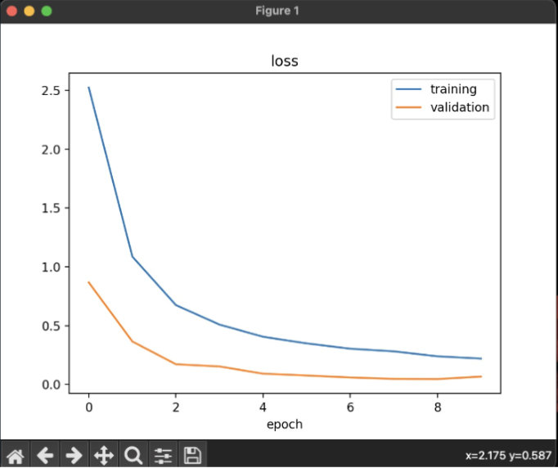
FINAL RESULTS
We can see that epochs are directly proportional to the accuracy and increasses with increase in epoch.
With the relative increase in the number of epochs the loss of the model decreases.

Slide 12
CONCLUSIONS
In conclusion, our CV project aimed to classify traffic signs in real-time using CNN, Keras, and TensorFlow.
We were successful in training our model on a large dataset of traffic sign images, and our model showed good accuracy during training and got 98% accuracy while training.
However, when we tested our model on the test data, we were unable to accurately predict the traffic signs, indicating that there is still room for improvement in our model.
INTERSECTION
DATASET

Slide 13
ROLE OF EACH GROUP MEMBER IN THE PROJECT
1
Manan: implementing model and understanding libraries
2
Harshrajsinh: data pre-processing, data visualization and report
3
Pruthviraj: Handling imbalance using data augmentation and report
4
Mohsinali: implementing and testing model and report

Slide 14
REFERENCES
A. Kapoor, N. Nehra, and D. Deshwal, “Traffic signs recognition using CNN,” in 2021 International Conference on Industrial Electronics Research and Applications (ICIERA), 2021, pp. 1–4.
N. Veličković, Z. Stojković, G. Dimić, J. Vasiljević, and D. Nagamalai, “Traffic sign classification using Convolutional Neural Network.” .
S. Reddy, D. Dash, and N. Rakesh “Image Classification Using Machine Learning Techniques for Traffic Signal”. In Intelligent Data Communication Technologies and Internet of Things (pp. 233-244), Springer, Singapore 2021.
Luo, H., Yang, Y., Tong, B., Wu, F., & Fan, B. (2017). Traffic sign recognition using a multi-task convolutional neural network. IEEE Transactions on Intelligent Transportation Systems, 19(4), 1100-1111.
Shustanov, A., & Yakimov, P. (2017). CNN design for real-time traffic sign recognition. Procedia engineering, 201, 718-725.
Zhu, Y., Zhang, C., Zhou, D., Wang, X., Bai, X., & Liu, W. (2016). Traffic sign detection and recognition using fully convolutional network guided proposals. Neurocomputing, 214, 758-766.
A. Vennelakanti, S. Shreya, R. Rajendran, D. Sarkar, D. Muddegowda and P. Hanagal, "Traffic Sign Detection and Recognition using a CNN Ensemble," 2019 IEEE International Conference on Consumer Electronics (ICCE), Las Vegas, NV, USA, 2019, pp. 1-4, doi: 10.1109/ICCE.2019.8662019.
H. S. Lee and K. Kim, "Simultaneous Traffic Sign Detection and Boundary Estimation Using Convolutional Neural Network," in IEEE Transactions on Intelligent Transportation Systems, vol. 19, no. 5, pp. 1652-1663, May 2018, doi: 10.1109/TITS.2018.2801560.

